Slide 1

Basics
By Green Pioneer

Slide 2
The Plan
Story
Why
It will be a game changer
How
Alexa works
Skill terminology works
What
Can we do with it
Technology you will need
Skill

Slide 3
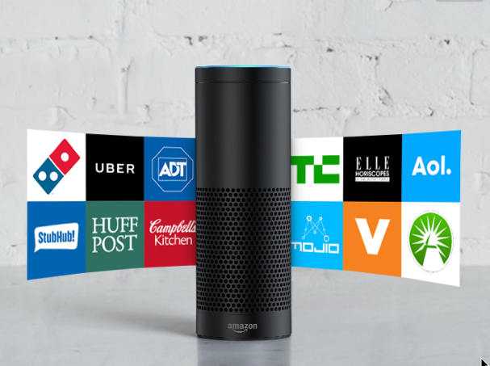
The Story
Notes:
Future in Households and Enterprises
My Vision
Automation
Anything is possible
Focus on more important things
Where its going

Slide 4
Why do we care about the alexa

Slide 5
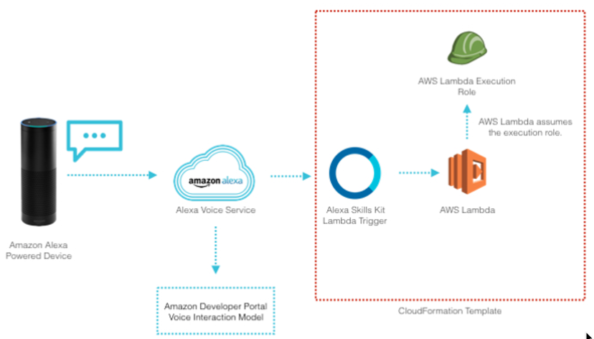
How does it work

Slide 6
Alexa Skill

Slide 7
What can we do with it

Slide 8
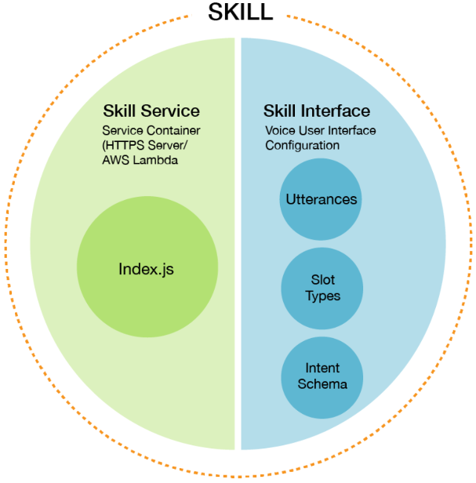
Alexa Skills
Notes:
Intents: An intent represents an action that fulfills a user’s spoken request. Intents can optionally have arguments called slots. Intents are specified in a JSON structure called the intent schema.
Sample utterances: A set of likely spoken phrases mapped to the intents. This should include as many representative phrases as possible.
Custom slot types: A representative list of possible values for a slot. Custom slot types are used for lists of items that are not covered by one of Amazon’s built-in slot types.
Dialog model (optional): A structure that identifies the steps for a multi-turn conversation between your skill and the user to collect all the information needed to fulfill each intent. This simplifies the code you need to write to ask the user for information.
https://developer.amazon.com/public/solutions/alexa/alexa-skills-kit/docs/defining-the-voice-interface#h2_sample_utterances

Slide 9
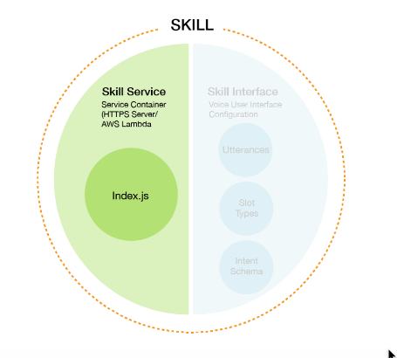
Skill Service

Slide 10
Skill Service

Slide 11
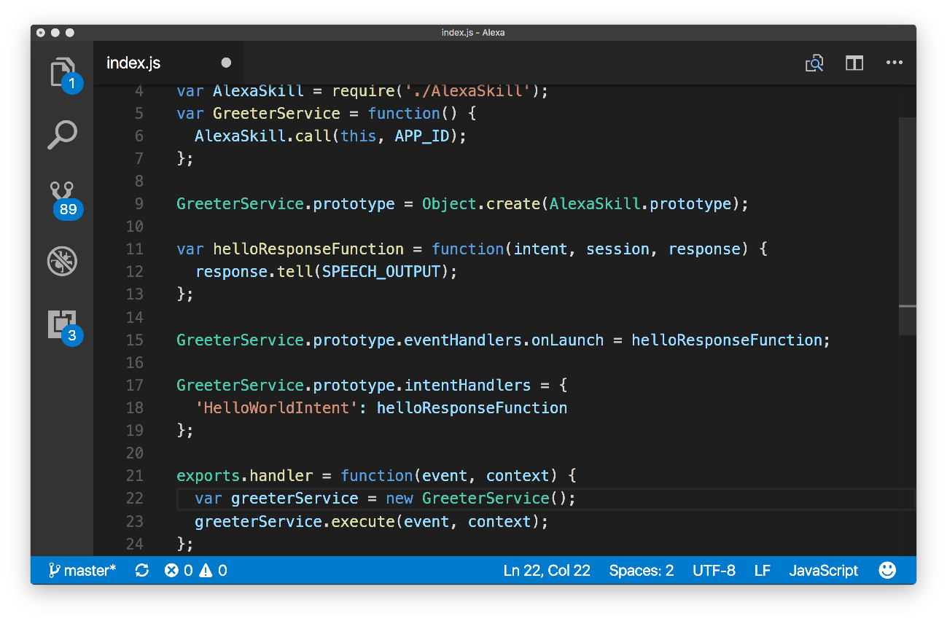
Skill Service - Code

Slide 12
Skill Service - Events
onLaunch
Event fired when skill is started
onSessionStarted
Called when the session starts
onIntent
Event fired when user specifics an intent

Slide 13
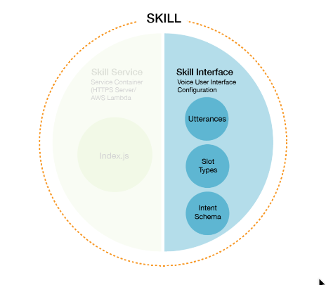
Skill Interface

Slide 14
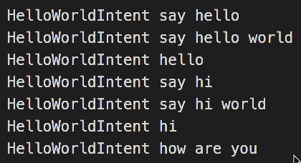
Skill Interface - Sample utterances
A set of likely spoken phrases mapped to the intents. This should include as many representative phrases as possible.
Notes:
A set of likely spoken phrases mapped to the intents. This should include as many representative phrases as possible.

Slide 15
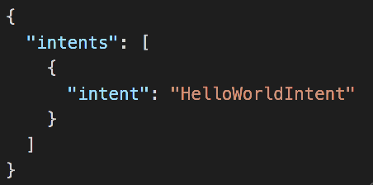
Skill Interface - Intents
An intent represents an action that fulfills a user’s spoken request. Intents can optionally have arguments called slots. Intents are specified in a JSON structure called the intent schema.
Notes:
An intent represents an action that fulfills a user’s spoken request. Intents can optionally have arguments called slots. Intents are specified in a JSON structure called the intent schema.

Slide 16
Skill Interface – Slot Types
getRespondMyName what was {NAME} famous for
Built-In
getAcronymMeaning what does {ACRONYMS} mean
Custom
Notes:
A representative list of possible values for a slot. Custom slot types are used for lists of items that are not covered by one of Amazon’s built-in slot types.

Slide 17
Built-In Slots
AMAZON.US_FIRST_NAME
AMAZON.DATE
AMAZON.DURATION
AMAZON.FOUR_DIGIT_NUMBER
AMAZON.NUMBER
AMAZON.TIME
AMAZON.US_CITY
AND MANY MORE

Slide 18
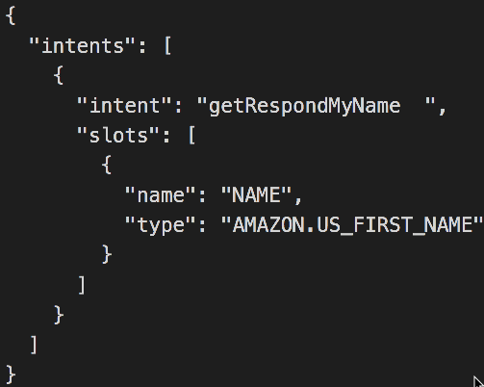

Slide 19
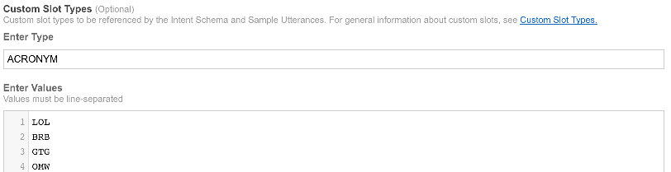
Custom Slots

Slide 20
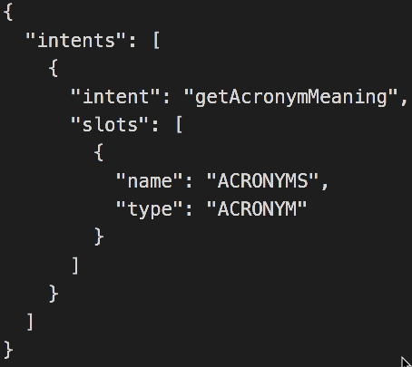

Slide 21
Alexa Skills
Notes:
Intents: An intent represents an action that fulfills a user’s spoken request. Intents can optionally have arguments called slots. Intents are specified in a JSON structure called the intent schema.
Sample utterances: A set of likely spoken phrases mapped to the intents. This should include as many representative phrases as possible.
Custom slot types: A representative list of possible values for a slot. Custom slot types are used for lists of items that are not covered by one of Amazon’s built-in slot types.
Dialog model (optional): A structure that identifies the steps for a multi-turn conversation between your skill and the user to collect all the information needed to fulfill each intent. This simplifies the code you need to write to ask the user for information.
https://developer.amazon.com/public/solutions/alexa/alexa-skills-kit/docs/defining-the-voice-interface#h2_sample_utterances

Slide 22
Alexa Interface Alexa Services

Slide 23
What Alexa Can Offer

Slide 24
Lets Build
Option 1
https://github.com/alexa/alexa-cookbook/tree/master/labs/HelloWorld
Option 2
https://developer.amazon.com/alexa-skills-kit/alexa-skill-quick-start-tutorial-nodejs
List of Options
https://github.com/alexa/alexa-cookbook/tree/master/context/lists

Slide 25
What you will need for today
Node
Visual Studio Code /Text Editor

Slide 26
Training
https://developer.amazon.com/alexa-skills-kit/alexa-skills-developer-training
https://developer.amazon.com/blogs/post/TxDJWS16KUPVKO/New-Alexa-Skills-Kit-Template-Build-a-Trivia-Skill-in-under-an-Hour

Slide 27
Resources
https://developer.amazon.com/alexa
https://alexa.devpost.com/
https://developer.amazon.com/public/solutions/alexa/alexa-skills-kit/getting-started-guide
https://developer.amazon.com/alexa-skills-kit
https://www.youtube.com/watch?v=QxgdPI1B7rg
https://github.com/alexa
https://github.com/alexa/alexa-cookbook
https://github.com/GreenPioneer/alexa
https://developer.amazon.com/public/solutions/alexa/alexa-skills-kit/docs/alexa-skills-kit-voice-design-best-practices
https://github.com/rmtuckerphx/alexa-skill-serverless-starter-template

